Slide 1
OmniServe AI – A Generative AI-Powered Smart Assistant for Restaurants & Clinics:
Streamlining Restaurant Ordering & Clinic Appointment Booking
Team Hackaholics
Atharva Salitri, Radha Waman, Saket Patayeet, Tanishq Thuse

Slide 2



Problem Statement
🔹 Restaurants face inefficiencies in menu-based ordering and customized meal recommendations.
🔹 Clinics struggle with manual appointment scheduling, leading to long wait times.
🔹 Existing systems lack multimodal interaction, limiting accessibility and ease of use.
🔹 There is a need for a scalable, AI-powered solution that enhances efficiency and user experience.

Slide 3
INTRODUCTION
OMNISERVE AI
🔹 The food and healthcare industries rely heavily on efficient ordering and scheduling.
🔹 Restaurants face challenges in managing orders, handling dietary preferences, and recommending meals.
🔹 Clinics struggle with manual appointment booking, availability management, and prioritizing urgent cases.
🔹 OmniServe AI is a Generative AI-powered assistant that automates restaurant ordering and clinic scheduling through text, voice, image, and document-based interactions.

Slide 4
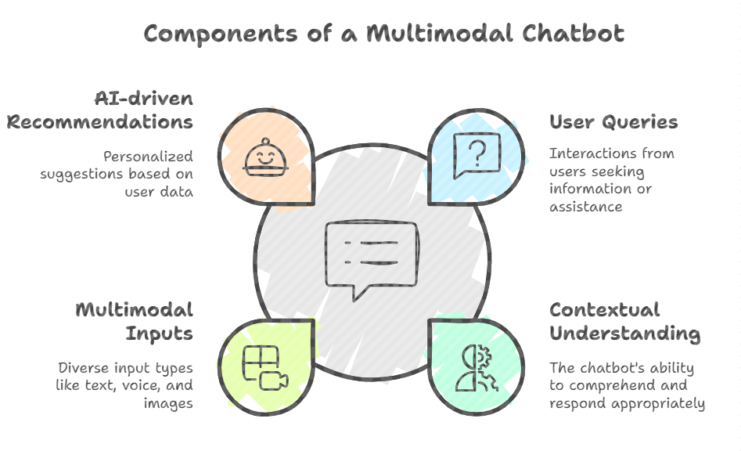
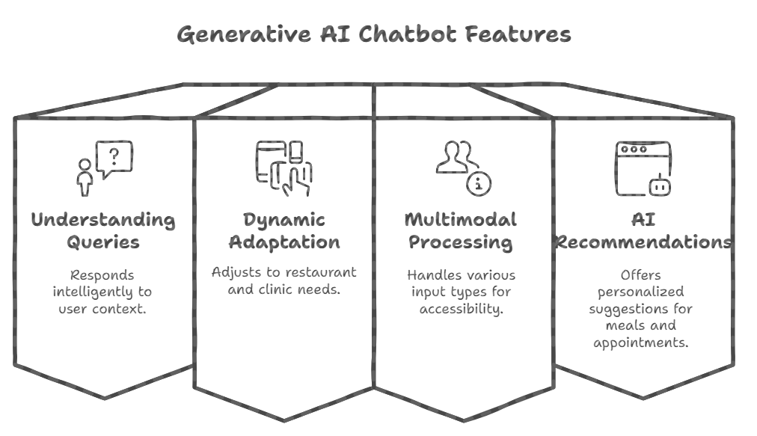
Our Solution - OmniServe AI
🚀 A Generative AI-powered multimodal chatbot that seamlessly integrates with restaurant and clinic workflows. ✅ Understands & responds intelligently to user queries based on context. ✅ Adapts dynamically to both restaurant ordering and clinic appointment booking. ✅ Utilizes multimodal input processing (text, voice, image, document uploads) for enhanced accessibility. ✅ Provides AI-driven recommendations for personalized meal selection and optimized appointment booking.

Slide 5
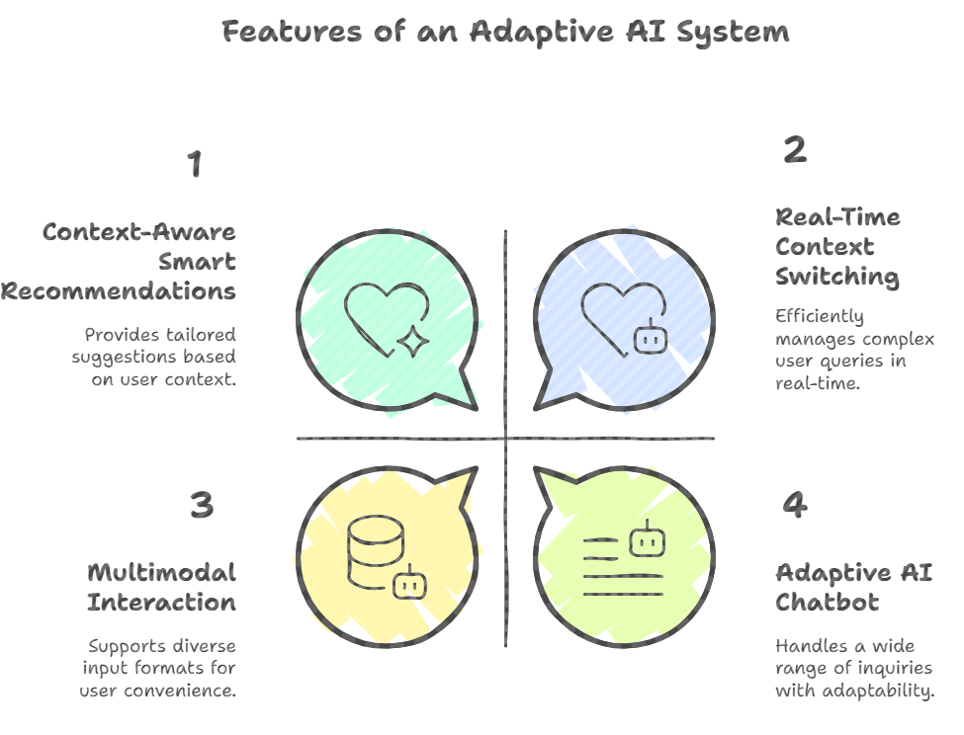
Key Features pt.1/2
🌟 Adaptive AI Chatbot: Conversational AI capable of handling restaurant and clinic-related inquiries.
🌟 Context-Aware Smart Recommendations: Suggests meals based on user preferences and suggests doctors based on symptoms.
🌟 Multimodal Interaction: Accepts text, voice, PDFs, images, and structured data (CSV).
🌟 Real-Time Context Switching: AI identifies whether the user is asking about food orders or medical appointments and responds accordingly.

Slide 6
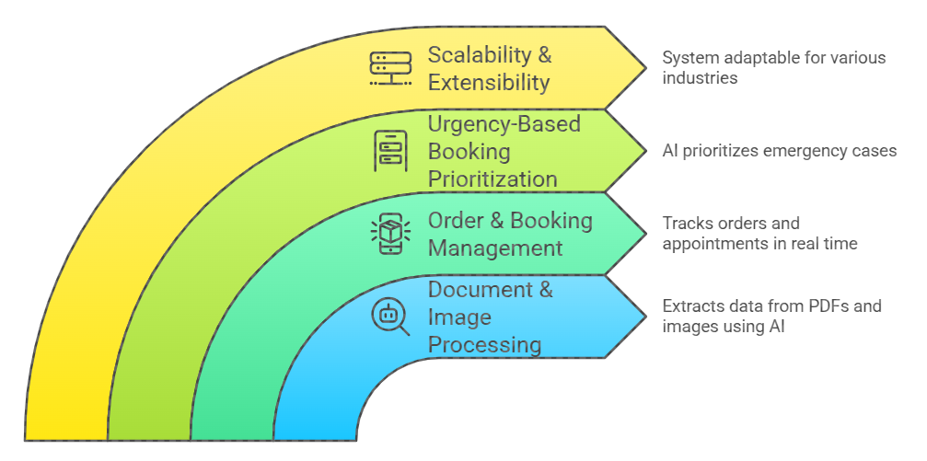
Key Features pt.2/2
🌟 Document & Image Processing: Extracts data from menu PDFs, doctor schedules, and prescriptions using AI-based parsing. 🌟 Order & Booking Management: Tracks restaurant orders and clinic appointments in real time with notifications. 🌟 Urgency-Based Booking Prioritization: AI prioritizes emergency cases in clinics based on user inputs. 🌟 Scalability & Extensibility: The system can be easily adapted for other industries, such as retail, logistics, and travel.

Slide 7

How It Works?
1️⃣ User Interaction: The user submits queries via text, voice, image, or document upload. 2️⃣ AI Processing: Gemini AI interprets input, extracts relevant data, and understands user intent. 3️⃣ Database Querying: The system fetches relevant menu/doctor schedule details based on the request. 4️⃣ AI-Powered Decision Making: AI provides personalized recommendations for meals or doctors. 5️⃣ Action Execution: The system confirms orders/bookings, generates notifications, and tracks progress.

Slide 8
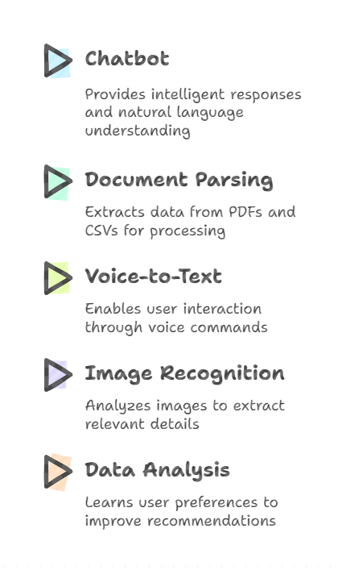
AI Capabilities in OmniServe AI
🧠 Gemini AI-powered chatbot for natural language understanding and intelligent responses.
📄 Document Parsing: Extracts information from PDFs and CSVs (restaurant menus, doctor schedules).
🎤 Voice-to-Text Processing: Allows users to interact via voice commands.
📷 Image Recognition: Reads menu images and prescriptions, extracting relevant details for processing.
📊 Smart Data Analysis: Learns user preferences over time to enhance recommendations.

Slide 9
Restaurant & Clinic Use Case
For Restaurant Online Ordering System:
For Clinic Appointment Booking System
🏥 Users can ask: "Which doctors are available on March 25?" → AI fetches doctor schedules.
🏥 Users can upload: A doctor availability CSV, and AI updates the system accordingly.
🏥 Users can provide symptoms: "I have a fever and body pain" → AI recommends a General Physician.
🏥 Urgency Detection: AI prioritizes emergency cases, suggesting immediate consultation or emergency care.
🏥 And Much More …
🍽️ Users can ask: "What gluten-free dishes do you offer?" → AI filters and provides menu options. 🍽️ Users can upload: A menu image or PDF, and AI extracts dish details. 🍽️ Users can place an order: AI suggests combos based on past orders and preferences. 🍽️ Order Tracking: Users receive updates on estimated preparation & delivery time.
🍽️ And Much More …

Slide 10
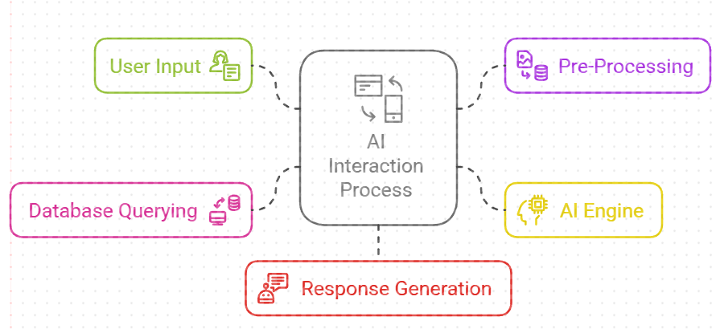
System Architecture
🔹 User Input: (Text, Voice, Image, PDF, CSV)
🔹 Pre-Processing: Speech-to-Text, OCR for image & document parsing
🔹 AI Engine (Gemini AI): NLP processing for understanding queries
🔹 Database Querying: Fetches relevant menu items, doctor availability, or order/appointment status
🔹 Response Generation: Personalized recommendations and action execution (order placement, appointment booking)

Slide 11



Tech stack and Requirements
🧠 Gemini AI-powered chatbot for natural language understanding and intelligent responses.
📄 Document Parsing: Extracts information from PDFs and CSVs (restaurant menus, doctor schedules).
🎤 Voice-to-Text Processing: Allows users to interact via voice commands.
📷 Image Recognition: Reads menu images and prescriptions, extracting relevant details for processing.
📊 Smart Data Analysis: Learns user preferences over time to enhance recommendations.

Slide 12
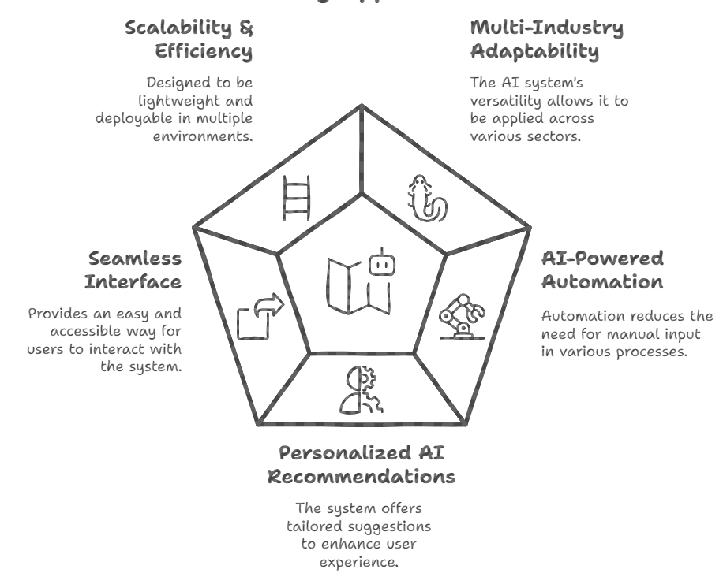
Unique Selling Points
🌟 Multi-Industry Adaptability: Can be repurposed for retail, e-commerce, healthcare, and more.
🌟 AI-Powered Automation: Minimizes manual intervention in appointment scheduling and food ordering.
🌟 Personalized AI Recommendations: Enhances user experience with tailored suggestions.
🌟 Seamless & Accessible Interface: Enables easy interaction via text, voice, and document uploads.
🌟 Scalable & Efficient: Designed to be lightweight, extensible, and deployable on cloud or local systems.

Slide 13
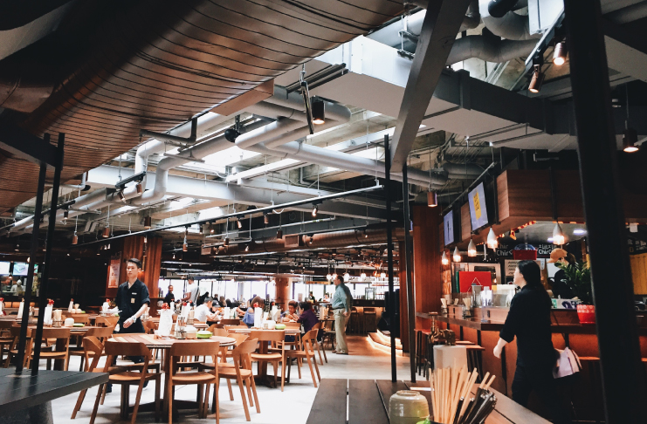

Societal Impact & Benefits
✔️ Reduces Manual Effort: Automates scheduling & order processing for businesses. ✔️ Improves Accessibility: Voice-based & image-based interaction benefits elderly and disabled users. ✔️ Saves Time & Boosts Efficiency: Faster response times for users, reducing wait times. ✔️ Minimizes Errors: AI ensures accurate order processing & booking, reducing human mistakes. ✔️ Supports Business Growth: AI-powered automation allows restaurants & clinics to scale efficiently.

Slide 14
CONCLUSION
OmniServe AI successfully addresses inefficiencies in restaurant ordering & clinic appointment booking.
1
2
3
OmniServe AI Revolutionizes Service Automation
✔️ Enhances restaurant ordering and clinic appointment booking through AI ✔️ Uses multimodal inputs for a seamless user experience. ✔️ Gemini AI-driven recommendations optimize meal selection and doctor appointments.
Impact on Businesses & Users
✔️ Reduces manual workload for restaurant staff and clinic administrators. ✔️ Improves accessibility and efficiency, benefiting customers and patients. ✔️ Minimizes errors and wait times, leading to better service quality.
Scalability & Future Potential
✔️ Easily adaptable to other industries, including retail, travel, and customer support. ✔️ Cloud-based and scalable, allowing expansion to multiple locations. ✔️ Future upgrades may include AI-driven analytics for demand forecasting and user behavior insights.

Slide 15
Thank
You!

